Slide 1
Chapter 10
Fact-Finding Techniques
Transparencies

Slide 2
Chapter 10 - Objectives
When fact-finding techniques are used in the database application lifecycle.
Types of facts collected in each stage of database application lifecycle.
Types of documentation produced in each stage of database application lifecycle.
Most commonly used fact-finding techniques.

Slide 3
Chapter 10 - Objectives
How to use each fact-finding technique and the advantages and disadvantages of each.
How to apply fact-finding techniques to early stages of database application lifecycle.

Slide 4
Fact-Finding Techniques
Critical to capture necessary facts to build the required database application.
These facts are captured using fact-finding techniques.
Formal process of using techniques such as interviews and questionnaires to collect facts about systems, requirements, and preferences.

Slide 5
When Are Fact-Finding Techniques Used?
Fact-finding used throughout database application lifecycle. Crucial to early stages including database planning, system definition, and requirements collection and analysis stages.
Enables developer to learn about the terminology, problems, opportunities, constraints, requirements, and priorities of the organization and the users of the system.

Slide 6
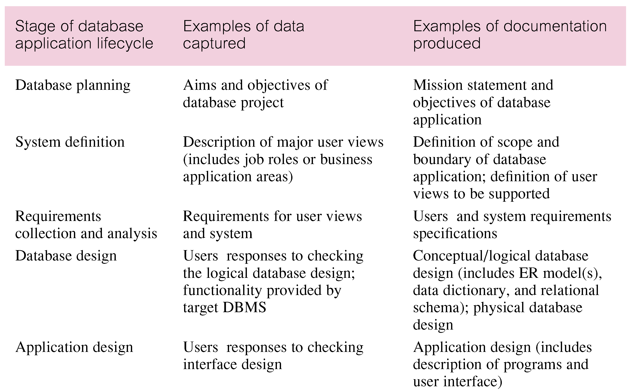
Examples of Data Captured and Documentation Produced during the Database Application Lifecycle

Slide 7
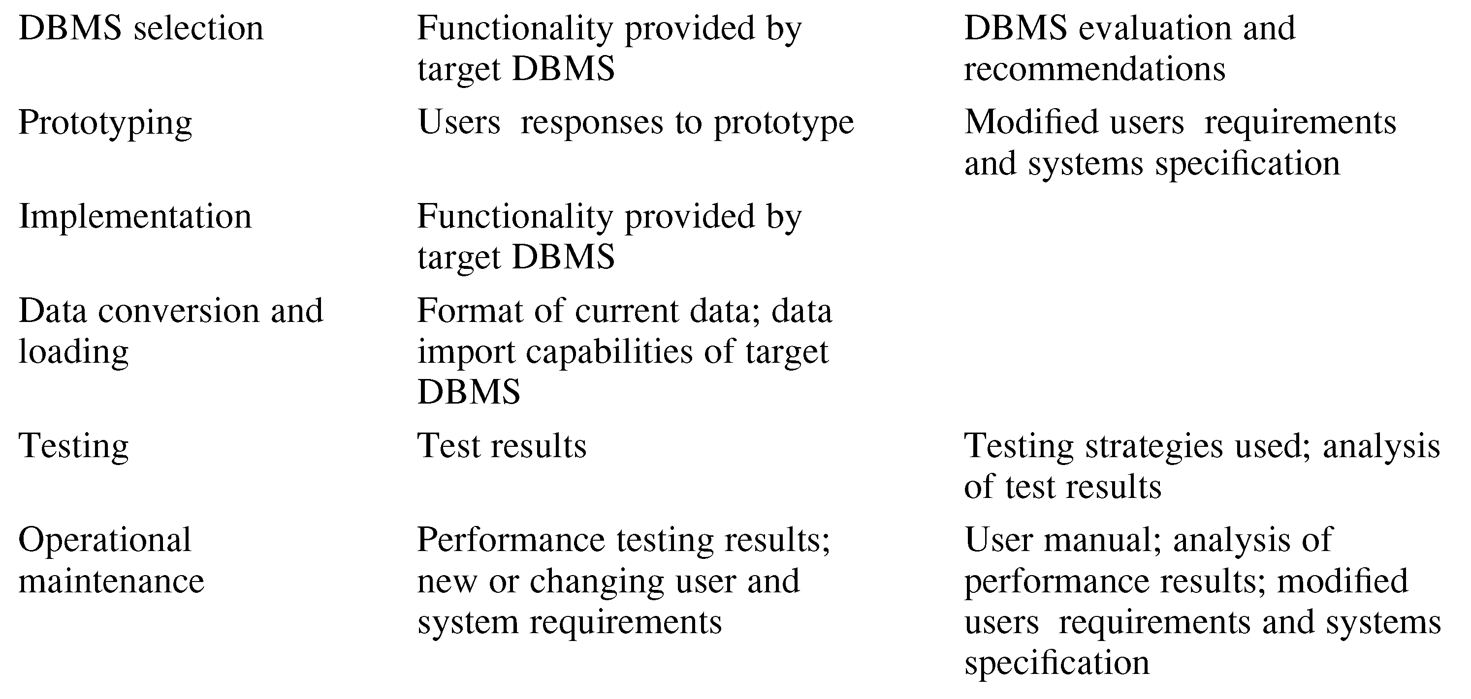
Examples of Data Captured and Documentation Produced during the Database Application Lifecycle

Slide 8
Fact-Finding Techniques
Database developer normally uses several fact-finding techniques during a single database project including:
  examining documentation,
  interviewing,
  observing organization in operation,
  research,
  questionnaires.

Slide 9
Examining Documentation
Can be useful:
  to gain some insight as to how the need for a database arose;
  to identify the part of the organization associated with the problem;
  to understand the current system.

Slide 10
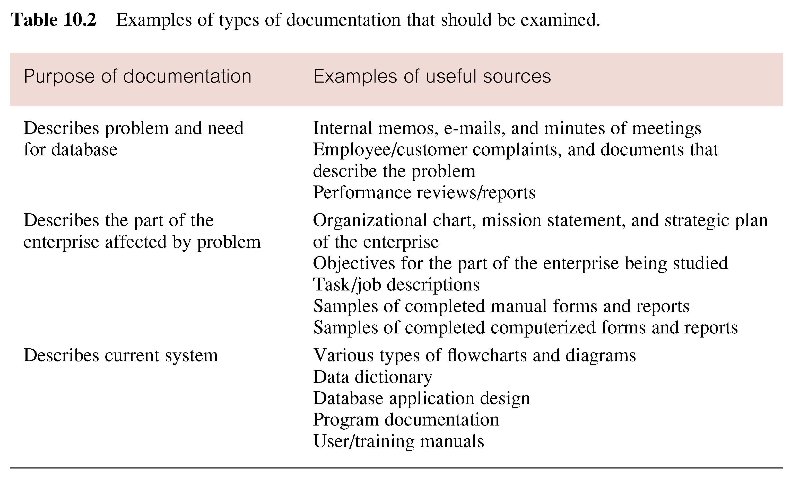
Examples of types of documentation that should be examined

Slide 11
Interviewing
Most commonly used, and normally most useful, fact-finding technique.
Enables collection of information from individuals face-to-face.
Objectives include finding out facts, verifying facts, clarifying facts, generating enthusiasm, getting end-user involved, identifying requirements, and gathering ideas and opinions.

Slide 12
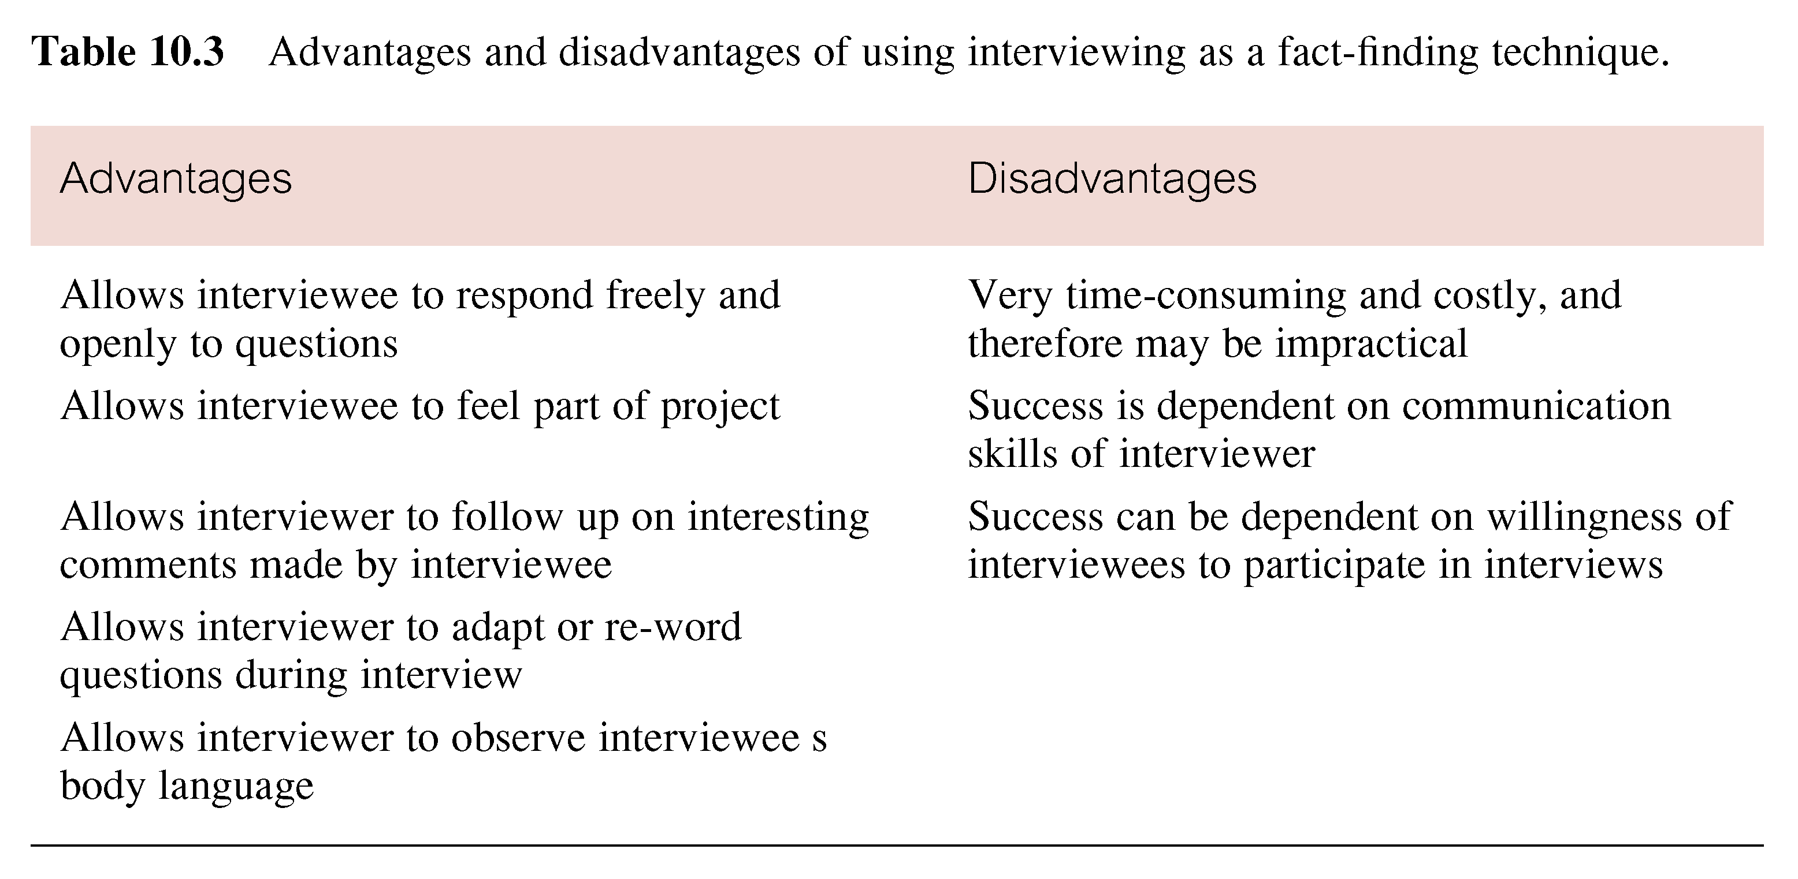
Advantages and Disadvantages of Interviewing

Slide 13
Interviewing
Two types of interviews: unstructured and structured.
Open-ended questions allow interviewee to respond in any way that seems appropriate.
Closed-ended questions restrict answers to either specific choices or short, direct responses.

Slide 14
Observing the Organization in Operation
Effective technique for understanding system.
Possible to participate in, or watch, a person perform activities to learn about system.
Useful when validity of data collected is in question or when complexity of certain aspects of system prevents clear explanation by end-users.

Slide 15
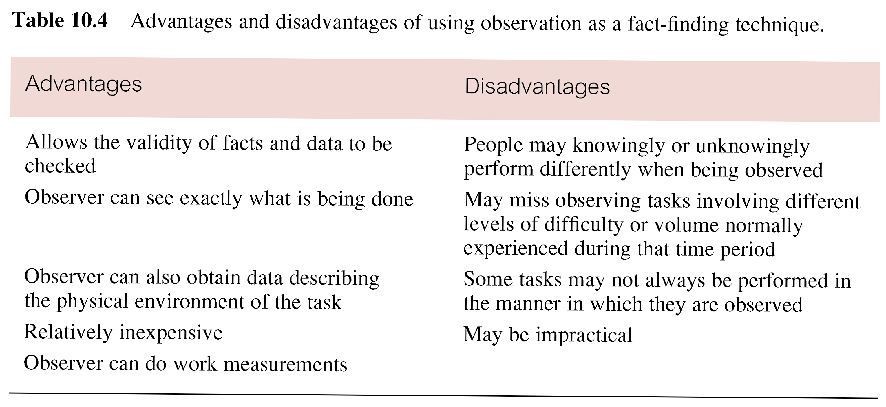
Advantages and Disadvantages of using Observation

Slide 16
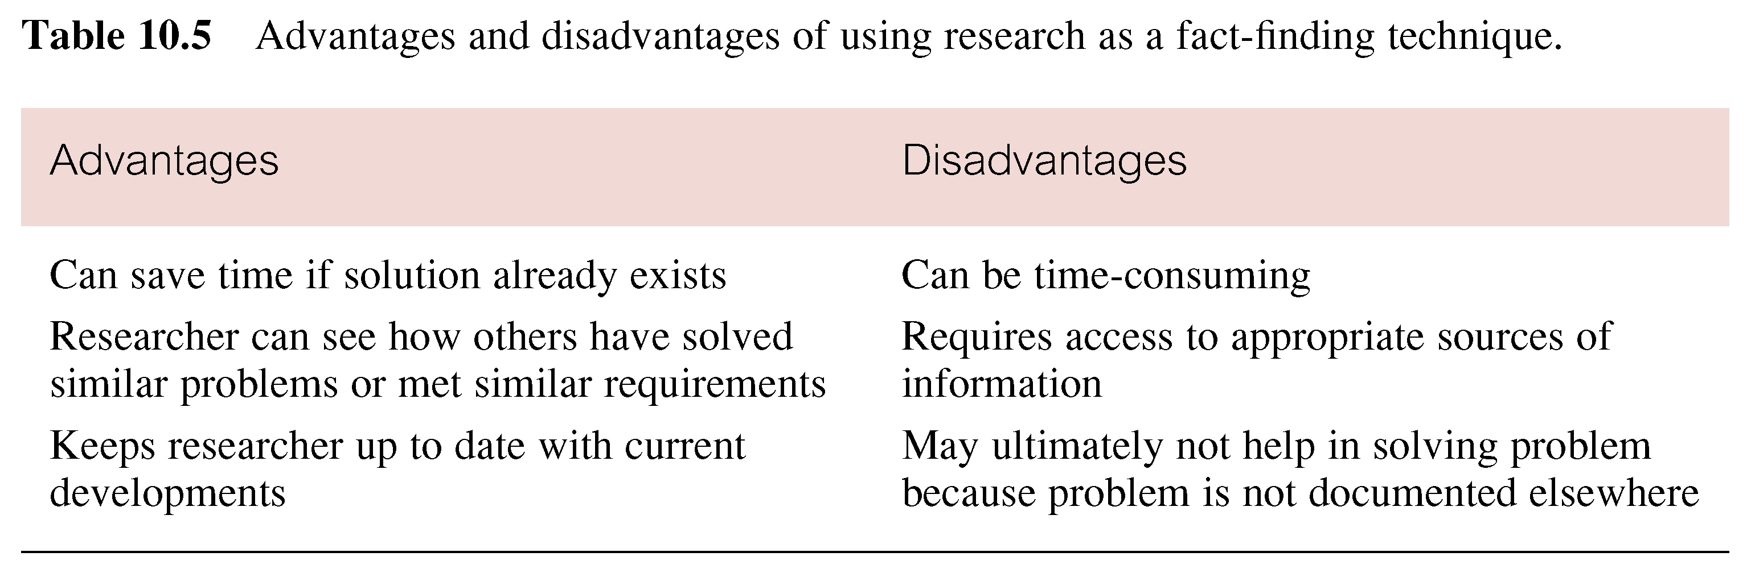
Advantages and Disadvantages of using Research

Slide 17
Research
Useful to research application and problem.
Use computer trade journals, reference books, and Internet (including user groups and bulletin boards).
Provide information on how others have solved similar problems, plus whether or not software packages exist to solve, or even partially solve, the problem.

Slide 18
Questionnaires
Conduct surveys through questionnaires – special-purpose documents that allow facts to be gathered from a large number of people while maintaining some control over their responses.
Two types of questions, namely free-format and fixed-format.

Slide 19
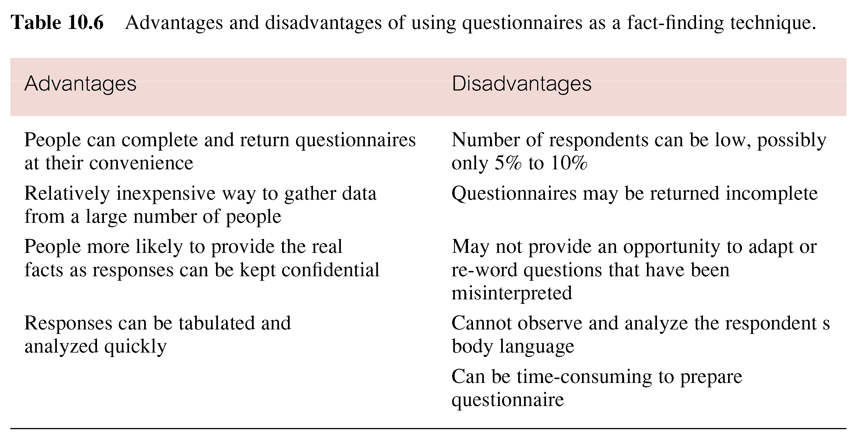
Advantages and Disadvantages of using Questionnaires

